Slide 1
Global
Corruption Perception Index (CPI)
Transparency International
2013
www.transparentnost.org.rs
http://www.transparency.org/research/cpi/overview

Slide 2
Corruption Perception Index for 2013
Global (177 states/territories)
agregate Index (from 13 different sources of data)
that measures perception (experts/businessmen) corruption (“abuse of entrusted power for private gain”)
in public sector (state officials and public servants)

Slide 3
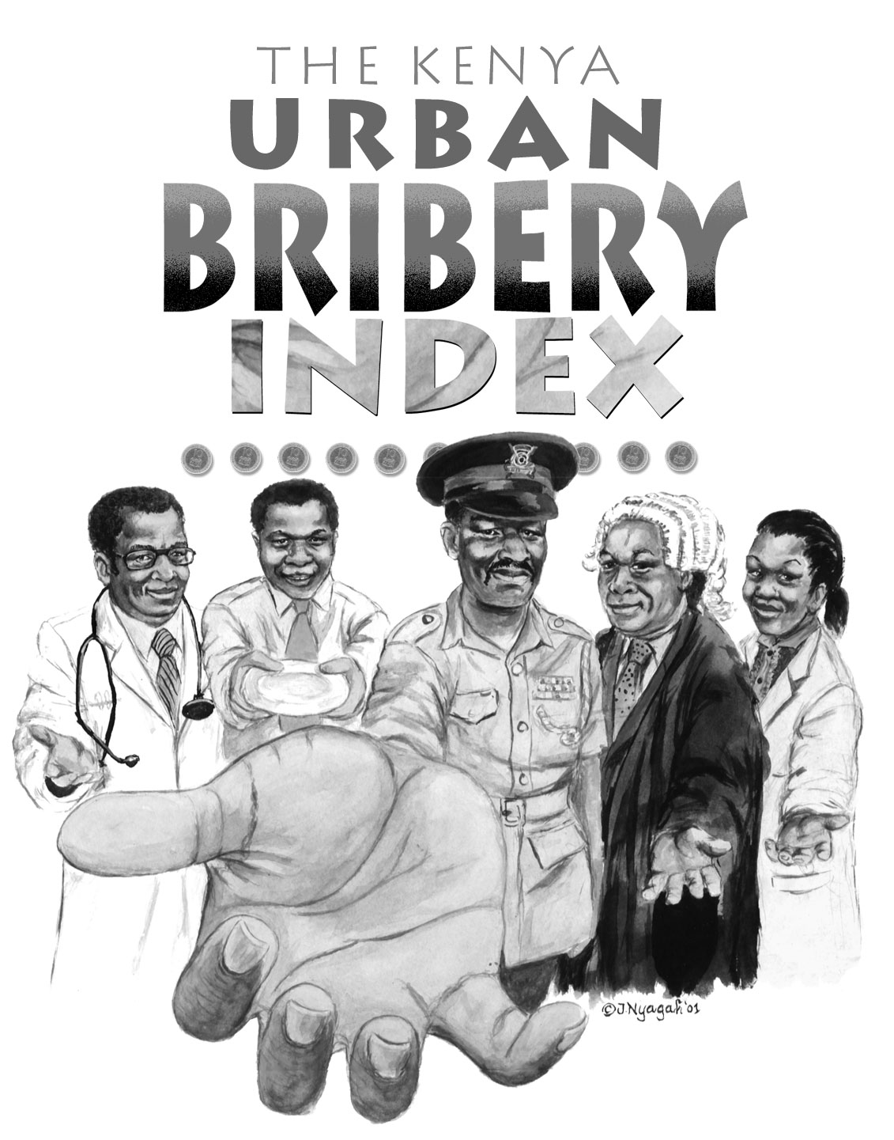
Corruption Perception Index for 2013
Measures the level of how corrupt public sector is perceived to be (corruption among state officials and public servants)
Index is created on the basis of 13 different researches and studies, conducted by independent institutions, questioning entrepreneurs, analysts and local experts
In 2013 total of 177 states/territories are ranked, one more compared to 2012

Slide 4
Goals of CPI
To measure the perception of corruption presence in the public sector by businessmen, experts and risk analysts
To promote comparative understanding of corruption level
To offer overview on perception of decisions makers that influence trade and investments
CPI is “cumulative research” (research of group of researches), designed to overcome deficiencies of each individual research on corruption
To stimulate scientific researches, analysis of cause and consequences of corruption both in international and domestic level
To contribute to raising public awareness on corruption – to create positive climate for changes
Notes:
The pernicious effects of corruption damage all aspects of life and society.

Slide 5
Improvement of CPI methodology with the beginning of 2012
CPI is “research of group of researches” conducted annually that provides data that could be monitored continuously.
Minimum 3 researches per country/territory to be included in the list
Research covers the period of previous 24 months
Countries are ranked on a scale from 100 (very ‘clean’) to 0 (very corrupted), which allows detailed classification (smaller number of countries that share the same score
Perception and not the facts are being researched (e.g. number of convictions, number of media releases)
Notes:
The pernicious effects of corruption damage all aspects of life and society.

Slide 6
Possibility of comparison
Index represents overview of businessmen and analysts' perceptions on situations in certain countries and doesn’t necessarily reflect certain annual trends
Score is more relevant than the place on the list (because sometimes number of states/tterritories involved, changes)
Smaller changes in the score are not necessarily consequence of significant change in corruption perception, but of the researches comprehended with sample
Possibility of comparison: CPI 2013 is possible to compare fully with the CPI 2012 (country’s/territory’s score). Due to methodology changes, possibility of comparison of CPI 2012 with previous years is limited: ranking in the list can be compared (taking into consideration changes of number of countries in the sample), comparing with development of other countries or comparing of the results by individual researches; it is not methodologically correct to multiply score from previous years with 10 or to share current one with 10!
Notes:
The pernicious effects of corruption damage all aspects of life and society.

Slide 7
Deficiencies and advantages of CPI
Deficiencies:
Index does not reflect level of efforts invested into fight against corruption
Developing countries can be shown in worst light due to impartiality and prejudices of foreign observers (that’s why there are other means for measuring corruption)
Advantages:
Other tools for estimation of corruption lead to similar results as CPI
CPI is a good chance to promote public debate on corruption
CPI is good incentive for conducting further analysis
CPI includes almost all the countries of the world

Slide 8
CPI 2013 – The best and the worst
Countries perceived as the less corrupted
Rank | Country | Score (0-100) | No. researches
1 | Denmark New Zeeland | 91 91 | 7 7
3 | Finland Sweden | 89 89 | 7 7
Countries perceived as the most corrupted
Rank | Country | Score (0-100) | No. researches
174 | Sudan | 11 | 6
175 | Somalia North Korea Afganistan | 8 8 8 | 4 3 3

Slide 9
Methodology remarks for Serbia CPI 2013.
Serbia is included in 7 polls that are taken into consideration when creating the Index
Observed territory of Serbia without Kosovo and Metochy (researches on the basis of which CPI is created are separately made for that territory and reflect perception on corruption of their public services, so that Kosovo is separately ranked on this list)
Researches that are relevant to Serbia were published by august 2013. Four researches refer to 2013, while three in significant level contain data from 2012. Ranking by individual researches is from 36 to 48. Standard deviation is within acceptable limits (3.4) and allows high level of reliability.

Slide 10
Source of data in initial researches relevant to Serbia
 | Source | Sample
1 | FH (Freedom House, Nations in Transit) 2013 | Perception of nonresidents; examinees come mainly from developed countries.
2 3 4 5 | BF (Bertelsmann Foundation) Transformation Index 2014 EIU (Economist Intelligence Unit) GI (Global Insight Country Risk Ratings) PRS ICRG (Political Risk Services International Country Risk Guide) | Experts hired by the bank/ institution
6 | WEF (Report of the World Economic Forum, Executive Opinion Survey) 2013 | Perception of residents; examinees are mostly local experts, local businessmen and multinational companies
7 | WJP (World Justice Project Rule of Law Index) 2013 | Local experts and general population
Notes:
The pernicious effects of corruption damage all aspects of life and society.

Slide 11
CPI 2013 – former SFRY’s republics
Rank | Country | Score 2013 | Number of researches – CPI 2013
43 | Slovenia | 57 | 9
57 | Croatia | 48 | 9
67 | Macedonia | 44 | 6
67 | Montenegro | 44 | 4
72 | B & H | 42 | 7
72 | Serbia | 42 | 7

Slide 12
Evaluation of Serbia by sources for 2011, 2012 and for 2013
 | CPI 2011 (by new methodology) | CPI 2012 | CPI 2013
BF | 49 | 49 | 53
EIU | 38 | 38 | 38
FH | 47 | 47 | 47
GI | 42 | 42 | 52
PRS ICRG | 31 | 31 | 31
WEF | 35 | 35 | 37
WJP | / | 35 | 35
Number of researches | 6 | 7 | 7
Evaluation | 40 | 39 | 42

Slide 13
Former socialist countries of Europe by index (according to estimation on a scale from 0 to 100)
Estonia 68
Poland 60
Lithuania 57
Slovenia 57
Hungary 54
Letonia 53
Georgia 49
Czech 48
Croatia 48
Slovakia 47
Macedonia 44
Montenegro 44
Romania 43
B and H 42
Serbia 42
Bulgaria 41
Armenia 36
Moldavia 35
Albania 31
Belarus 29
Russia 28
Ukraine 25

Slide 14
Comparison
Countries that were ranked the same, and are now behind of us:
Countries that were before us, and are now behind:
Country | CPI 2013 | CPI 2012
Serbia | 42 | 39
Sri Lanka | 37 | 40
Liberia Bulgaria | 38 41 | 41 41
Country | CPI 2013 | CPI 2012
Serbia | 42 | 39
China | 40 | 39
Trinidad and Tobago | 38 | 39

Slide 15
Reactions to recent rankings
Data from 2000: facing the disastrous picture of Serbia
2003: Larger progress on a scale was expected, but perception slowly changes
2004: New breakthrough – approaching to realistic view of the situation
2005, 2006 and 2007: Minimum progress trend maintained – no radical changes that would lead to fast change in corruption perception
2008: Stagnation – fist time not even minimal progress, other countries catching up or even outpacing
2009: Simbolical progress
2010: Stagnation and expectation that improving of legal framework will bring future progress
2011: decline of score and regressing on the list
2012: same reactions as in previous year
2013: Mild progress

Slide 16
Results of CPI and Serbia for 2013
Countries can ignore results of CPI only at their own damage – even if it doesn’t reflect completely real state, CPI is a good indicator of what other people think of us – no room for satisfaction!
Serbia is still considered as a country with high corruption level, changes similar to those that occur in region.
Citizens of Serbia have also impression on highly corrupted public area, which derives from result of research made on a national sample (e.g. Global Corruption Barometer)
Progress is noticed in three of seven sources used for creation of CPI

Slide 17
Potential discussion topics
What is the ration between the perception and real level of corruption? When corruption is current topic it can lead to increase of perception on corruption, especially when corroborated with non selective and systemic measures for removing corruption and resolving of affairs. If the issue of corruption is followed by specific actions that can, in long term, lead to decrease in corruption perception.
Is it possible to influence to decrease of corruption perception with isolated anticorruption measures or campaigns? In most of the cases - no, due to nature of research. Besides, priority of state organs should be prevention, discovering and punishing of on-going corruption, rather than changing perception.

Slide 18
Main problems of Serbia
Violation of adopted anticorruption laws and violation of legal certainity by adopting contradictory or undetermined provisions
Insufficient capacities of supervising organs who perform control over implementation of the law; discretion authorities in determining subject of verification
Failure to draw a lesson on the basis of discovered corruption cases and revealed forms of corruptive behavior
Non institutional power of political parties which reflects the work of complete public sector
Insufficiently transparent process of decision making, impossibility of citizens to influence it and unorganized lobbing
Unnecessary procedures and state interventions that increase number of situations for corruption to occur

Slide 19
Priorities of Serbia in fight against corruption
Fight against corruption can be successful only if its organized systemically, ensuring the rule of law, if institutions’ work is coordinated with the strict respect of their constitutional and legal jurisdictions.
New National Anticorruption Strategy and Action Plan contain many useful measures, but the goals that are set are not sufficiently ambitious to induce important changes; while Strategy doesn’t state on certain very important matters such are: recently established system of “anticorruption coordination”, “chain of command” and choosing of high level corruption cases to investigate, matter of non transparent agreements and negotiation with foreign states, lenders and investors

Slide 20
Priorities of Serbia in fight against corruption
Providing greater transparency of state organs’ work (including rules on public debates and lobbying, increasing transparency of Governmental, public enterprises’ and of other institutions’ activities),
Decrease of regulatory and financial state interventions (e.g. license, approvals, subsidies) that create corruption risks,
Thorough reform of public sector
Respecting and strengthening the role of independent state organs and providing implementation of their decisions and recommendations
Providing transparency of media ownership and media financing

Slide 21
Priorities of Serbia in fight against corruption
Independent, efficient and accountable judiciary
Protection of whistleblowers and witnesses of corruption, proactive approach in investigating corruption and measures for control of public officials’ and servants’ property
Strict control of accuracy and completeness of reports on campaign and political party financing, investigating of suspicions and claims on buying of election votes and public resources abuse in election campaigns
Resolving of all cases with suspicion to corruption from previous years and establishing of state oppressive apparatus that will allow discovering and punishing of such actions later on, instead of recent mechanisms.

Slide 22
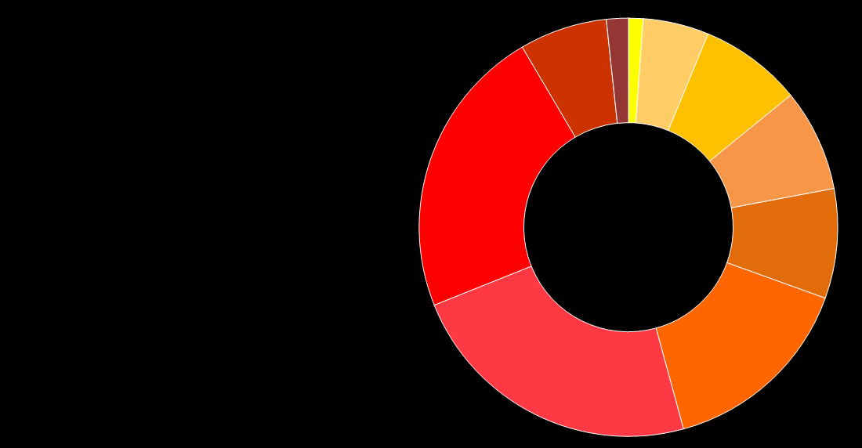
Corruption Perception Index 2013
Perceiving level of corruption in public sector in 177 states/territories worldwide.
Global results:
70% of countries have score less than 50 from possible 100.
43 is average estimation worldwide

Slide 23
Corruption Perception Index 2013
RANK |  | COUNTRY/ TERRITORY | SCORE
1 |  | Denmark | 91
1 |  | New Zealand | 91
3 |  | Finland | 89
3 |  | Sweden | 89
5 |  | Norway | 86
5 |  | Singapore | 86
7 |  | Switzerland | 85
8 |  | Netherlands | 83
9 |  | Australia | 81
9 |  | Canada | 81
11 |  | Luxembourg | 80
12 |  | Germany | 78
12 |  | Iceland | 78
14 |  | United Kingdom | 76
15 |  | Barbados | 75
15 |  | Belgium | 75
15 |  | Hong Kong | 75
18 |  | Japan | 74
19 |  | Uruguay | 73
19 |  | United States of America | 73
21 |  | Ireland | 72
22 |  | The Bahamas | 71
22 |  | Chile | 71
22 |  | France | 71
22 |  | Saint Lucia | 71
26 |  | Austria | 69
26 |  | United Arab Emirates | 69
28 |  | Estonia | 68
28 |  | Qatar | 68
30 |  | Botswana | 64
31 |  | Bhutan | 63
31 |  | Cyprus | 63
33 |  | Portugal | 62
33 |  | Puerto Rico | 62
33 |  | Saint Vincent and the Grenadines | 62
36 |  | Israel | 61
36 |  | Taiwan | 61
38 |  | Brunei | 60
38 |  | Poland | 60
40 |  | Spain | 59
41 |  | Cape Verde | 58
41 |  | Dominica | 58
43 |  | Lithuania | 57
43 |  | Slovenia | 57
45 |  | Malta | 56
46 |  | South Korea | 55
47 |  | Hungary | 54
47 |  | Seychelles | 54
49 |  | Costa Rica | 53
49 |  | Latvia | 53
RANK |  | COUNTRY/ TERRITORY | SCORE
49 |  | Rwanda | 53
52 |  | Mauritius | 52
53 |  | Malaysia | 50
53 |  | Turkey | 50
55 |  | Georgia | 49
55 |  | Lesotho | 49
57 |  | Bahrain | 48
57 |  | Croatia | 48
57 |  | Czech Republic | 48
57 |  | Namibia | 48
61 |  | Oman | 47
61 |  | Slovakia | 47
63 |  | Cuba | 46
63 |  | Ghana | 46
63 |  | Saudi Arabia | 46
66 |  | Jordan | 45
67 |  | Macedonia FYR | 44
67 |  | Montenegro | 44
69 |  | Italy | 43
69 |  | Kuwait | 43
69 |  | Romania | 43
72 |  | Bosnia and Herzegovina | 42
72 |  | Brazil | 42
72 |  | Sao Tome and Principe | 42
72 |  | Serbia | 42
72 |  | South Africa | 42
77 |  | Bulgaria | 41
77 |  | Senegal | 41
77 |  | Tunisia | 41
80 |  | China | 40
80 |  | Greece | 40
82 |  | Swaziland | 39
83 |  | Burkina Faso | 38
83 |  | El Salvador | 38
83 |  | Jamaica | 38
83 |  | Liberia | 38
83 |  | Mongolia | 38
83 |  | Peru | 38
83 |  | Trinidad and Tobago | 38
83 |  | Zambia | 38
91 |  | Malawi | 37
91 |  | Morocco | 37
91 |  | Sri Lanka | 37
94 |  | Algeria | 36
94 |  | Armenia | 36
94 |  | Benin | 36
94 |  | Colombia | 36
94 |  | Djibouti | 36
94 |  | India | 36
94 |  | Philippines | 36
94 |  | Suriname | 36

Slide 24
Corruption Perception Index 2013
RANK |  | COUNTRY/ TERRITORY | SCORE
102 |  | Ecuador | 35
102 |  | Moldova | 35
102 |  | Panama | 35
102 |  | Thailand | 35
106 |  | Argentina | 34
106 |  | Bolivia | 34
106 |  | Gabon | 34
106 |  | Mexico | 34
106 |  | Niger | 34
111 |  | Ethiopia | 33
111 |  | Kosovo | 33
111 |  | United Republic of Tanzania | 33
114 |  | Egypt | 32
114 |  | Indonesia | 32
116 |  | Albania | 31
116 |  | Nepal | 31
116 |  | Vietnam | 31
119 |  | Mauritania | 30
119 |  | Mozambique | 30
119 |  | Sierra Leone | 30
119 |  | East Timor | 30
123 |  | Belarus | 29
123 |  | Dominican Republic | 29
123 |  | Guatemala | 29
123 |  | Togo | 29
127 |  | Azerbaijan | 28
127 |  | Comoros | 28
127 |  | Gambia | 28
127 |  | Lebanon | 28
127 |  | Madagascar | 28
127 |  | Mali | 28
127 |  | Nicaragua | 28
127 |  | Pakistan | 28
127 |  | Russia | 28
136 |  | Bangladesh | 27
136 |  | Ivory Coast | 27
136 |  | Guyana | 27
136 |  | Kenya | 27
140 |  | Honduras | 26
140 |  | Kazakhstan | 26
140 |  | Laos | 26
140 |  | Uganda | 26
144 |  | Cameroon | 25
144 |  | Central African Republic | 25
144 |  | Iran | 25
144 |  | Nigeria | 25
144 |  | Papua New Guinea | 25
144 |  | Ukraine | 25
RANK |  | COUNTRY/ TERRITORY | SCORE
150 |  | Guinea | 24
150 |  | Kyrgyzstan | 24
150 |  | Paraguay | 24
153 |  | Angola | 23
154 |  | Republic of Congo | 22
154 |  | Democratic Republic of the Congo | 22
154 |  | Tajikistan | 22
157 |  | Burundi | 21
157 |  | Myanmar | 21
157 |  | Zimbabwe | 21
160 |  | Cambodia | 20
160 |  | Eritrea | 20
160 |  | Venezuela | 20
163 |  | Chad | 19
163 |  | Equatorial Guinea | 19
163 |  | Guinea Bissau | 19
163 |  | Haiti | 19
167 |  | Yemen | 18
168 |  | Syria | 17
168 |  | Turkmenistan | 17
168 |  | Uzbekistan | 17
171 |  | Iraq | 16
172 |  | Libya | 15
173 |  | South Sudan | 14
174 |  | Sudan | 11
175 |  | Afghanistan | 8
175 |  | North Korea | 8
175 |  | Somalia | 8

Slide 25
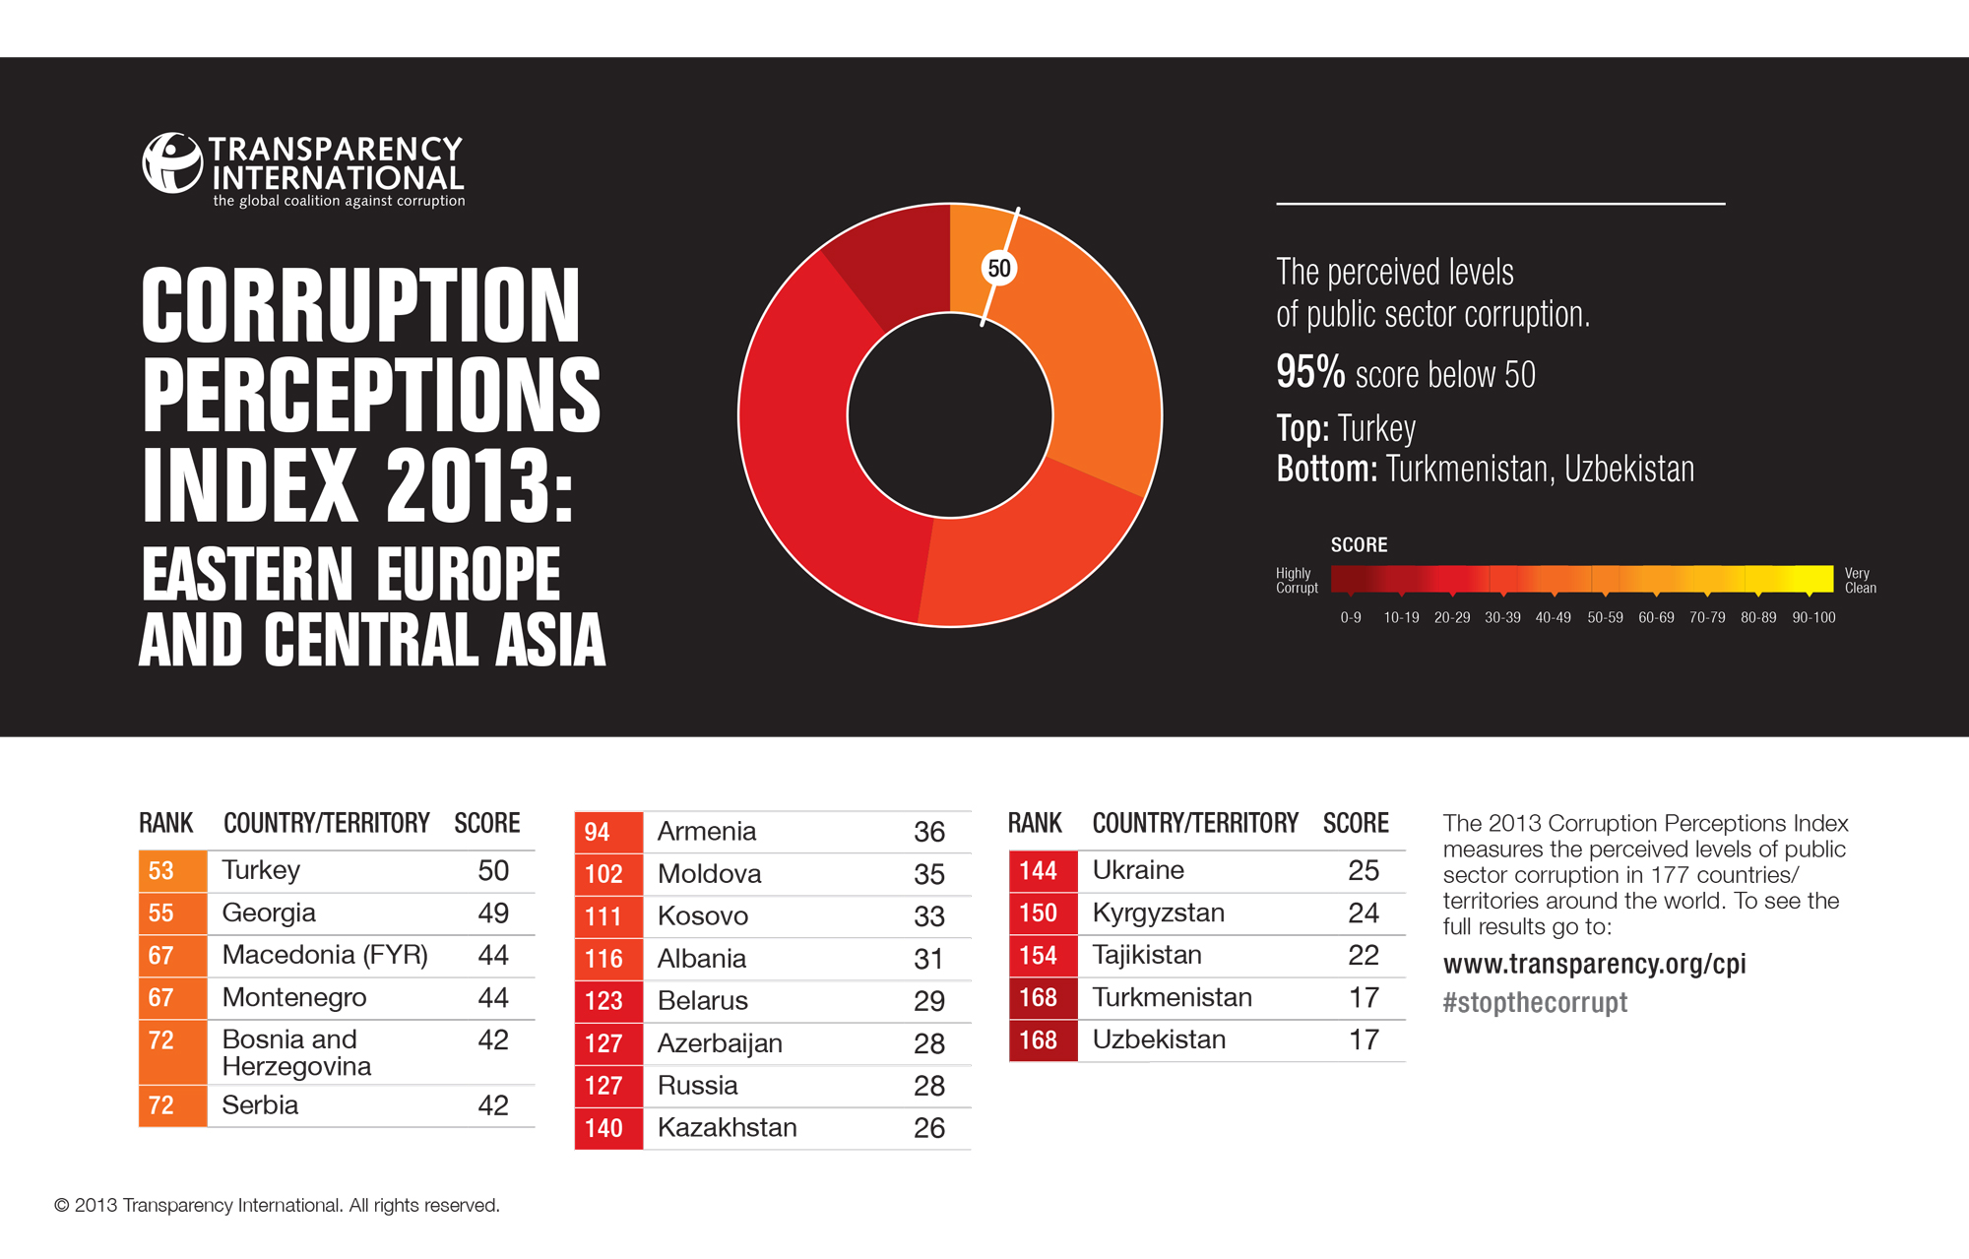

Slide 26
